Slide 1
Space complexity

Slide 2
The ability to calculate space complexity is essential in considering an algorithm’s efficiency. space complexity depends on a variety of things such as the programming language, the compiler, or even the machine running the algorithm. It is crucial for a data scientist programmer to choose the right data structures for the job. In particular, if the algorithms are computationally intensive such as the ones that train a machine learning model or algorithms that manipulate large volumes of data then it is wise to ensure that special care is taken in choosing the appropriate data structures.

Slide 3
Big-O measures the time complexity of the operations of an algorithm. It measures how long it takes for the algorithm to compute the required operation. Although we could also measure the space complexity (how much space an algorithm takes) but this article will focus on time complexity.
In simplest terms, Big O notation is a way to measure performance of an operation based on the input size, known as n.
We can use big O notnation in the same way to measure the space complexity of an algorithm. The basic idea is identical. The notion of space complexity becomes important when you data volume is of the same magntude orlarger than the memory you have available. In that case, an algorihtm with high space complexity may end up having to swap memory constantly, and will perform far worse than its Big O for time complexity would suggest.
Sometimes, you can trade space complexity for time complexity - caching and dynamic programming are obvious examples.

Slide 4
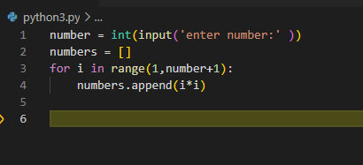
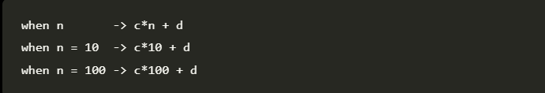
In this example, the length of the list we create depends on the input value we provide for ‘n’.
Let’s say adding a single integer to the list takes ‘c’ space and other initial operations, including creating a new list, takes ‘d’ space.
Then, we can create an equation for the space taken by the above algorithm like this.

Slide 5
The value calculated by this equation is the space the algorithm needs to complete execution. The values of the constants ‘c’ and ‘d’ are outside of the control of the algorithm and depend on factors such as programming language, hardware specifications, etc. However, we don’t need the exact value this equation calculates to talk about the space complexity of an algorithm. Instead, we use the highest order of the variable ‘n’ as a representative of the space complexity.

